Slide 1
Modules, Packages & Virtual Environments

Slide 2
https://github.com/Gromm21xx/Modules-Packages-VirtualEnvironments.git
Agenda
Introduction to Modules
Paths and Directories
Practical Exercise
Introduction to Packages
Practical Exercise
Introduction to Virtual Environments
Practical Exercise

Slide 3
https://github.com/Gromm21xx/Modules-Packages-VirtualEnvironments.git
Learning Outcomes
1. Understand the concept of modules and packages in Python and their advantages in writing modular and reusable code.
2. Learn how to organize code into modules and packages and how to import and use functions/classes from different modules within several packages.
3. Gain knowledge about external packages, pip install, and PyPI (Python Package Index).
4. Understand paths and how to refer to modules/packages.
5. Learn about requirements.txt, virtual environments (.venv), and how to create, activate, and deactivate them.

Slide 4
Introduction to Modules
Single files that contain Python Code
They can include functions, classes, and variables.
Organise code
Modular and reusable

Slide 5
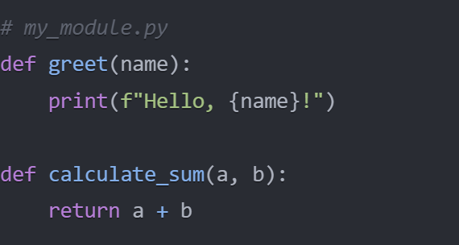
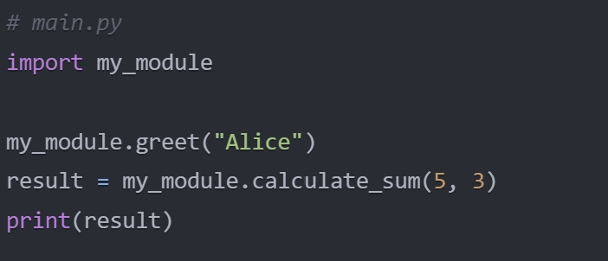
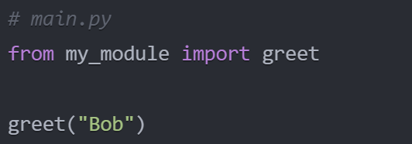
Creating Modules
Create a Python file with .py extension
Define functions, classes or variables
Import module into another Python file by using the import statement
Import specific function or class by using the from keyword

Slide 6

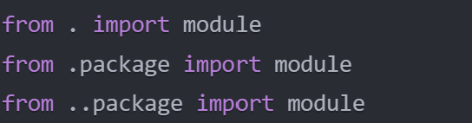
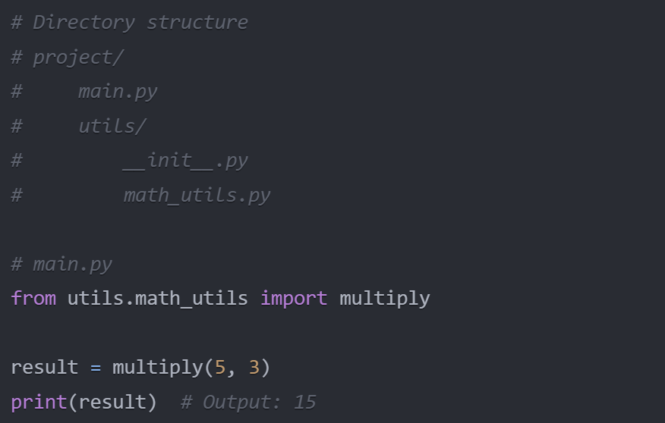
Understanding Paths and Importing Modules/Packages
There are two types of paths:
Absolute Paths:
An absolute path provides the complete location of a file or directory starting from the root directory of the file system.
It begins with the root directory and specifies the entire path to the desired file or directory.
Example (Windows): C:\Users\YourName\Documents\project\file.txt
Example (macOS/Linux): /home/YourName/Documents/project/file.txt
Relative Paths:
A relative path specifies the location of a file or directory relative to the current working directory.
It does not start with the root directory but instead uses the current location as a reference point.
Example: project/file.txt (assumes the current directory contains the "project" directory)

Slide 7
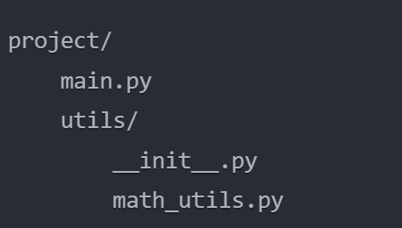
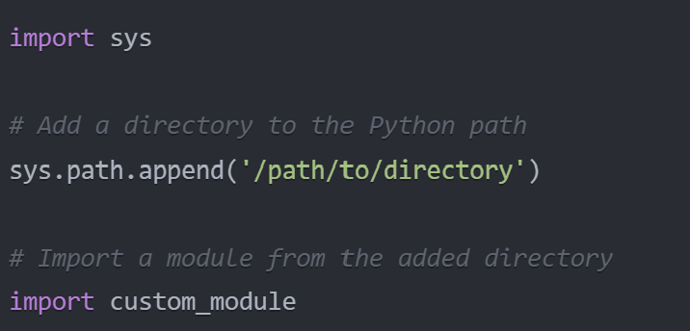
Python Path
The Python path typically includes the following locations:
The directory of the current script:
When you run a Python script, the directory containing the script is automatically added to the Python path.
This allows you to import modules and packages located in the same directory as the script.
The directories listed in the PYTHONPATH environment variable:
The PYTHONPATH environment variable is a list of directories that Python adds to the Python path.
You can set the PYTHONPATH variable to include additional directories where you have installed modules or packages.
To set the PYTHONPATH variable, you can use the following syntax:
Windows: set PYTHONPATH=C:\path\to\directory
macOS/Linux: export PYTHONPATH=/path/to/directory
The installation-dependent default directories:
Python also includes a set of default directories in the Python path.
These directories are specific to your Python installation and may include locations such as the Python standard library and site-packages directory.
The site-packages directory is where third-party packages installed using pip are typically located.

Slide 8
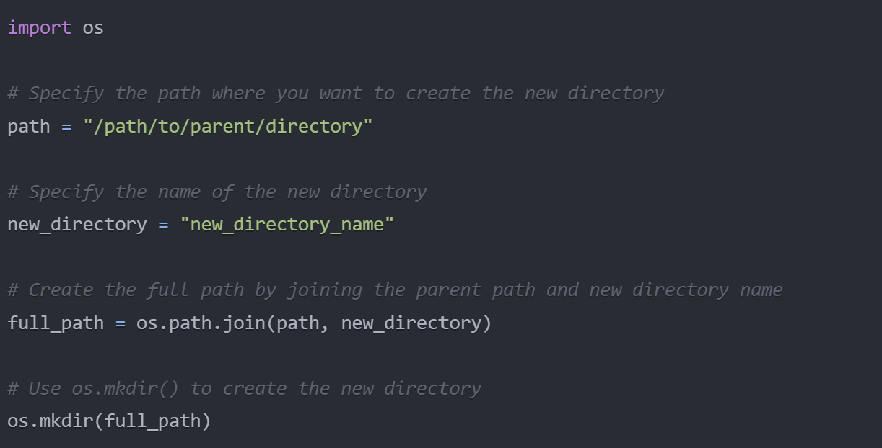
Directories
Import the os module
Specify the path where you want to create the new directory
Specify the name of the new directory you want to create
Create the full path by joining the parent path and the new directory name using os.path.join()
Use the os.mkdir() function to create the new directory at the specified path
Alternatively, you can use os.makedirs() instead of os.mkdir() if you want to create intermediate directories as well

Slide 9
https://github.com/Gromm21xx/Modules-Packages-VirtualEnvironments.git
Practical Exercise 1: Creating Modules
Exercise instructions:
Create a new directory called customer_management on your desktop.
Inside the customer_management directory, create a new file called customer.py.
Copy and paste the Customer class code from the previous session into customer.py.
Create another file in the customer_management directory called customer_utils.py.
In customer_utils.py, define two new utility functions:
get_preferred_customers(customers): This function should take a list of customer instances and return a list of preferred customers based on the criteria of total spent > 1000 or membership length > 2.
get_customer_emails(customers): This function should take a list of customer instances and return a list of their email addresses.
Create a new file in the customer_management directory called main.py.
In main.py, import the necessary classes and functions:
Import the pandas library.
Import the Customer class from the customer module.
Import the get_preferred_customers and get_customer_emails functions from the customer_utils module.
Load the "Ecommerce Customers.csv" dataset using pandas, just like in the previous session.
Create instances of the Customer class based on the dataset, similar to the previous session.
Use the newly created utility functions get_preferred_customers and get_customer_emails to perform operations on the customer instances.
Print the preferred customers' information and the list of customer emails.
Run the main.py script and observe the output.
Stretch Activity:
Open the customer_utils.py file.
Add a new utility function called get_top_spenders(customers, n) that takes a list of customer instances and an integer n as parameters. This function should return the top n customers based on their total amount spent.
Open the main.py file and import the get_top_spenders function from the customer_utils module.
Call the get_top_spenders function with the list of customers and a desired value of n, and print the information of the top spenders.

Slide 10
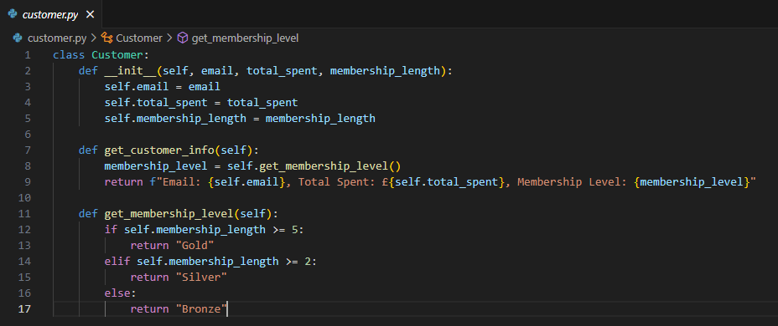
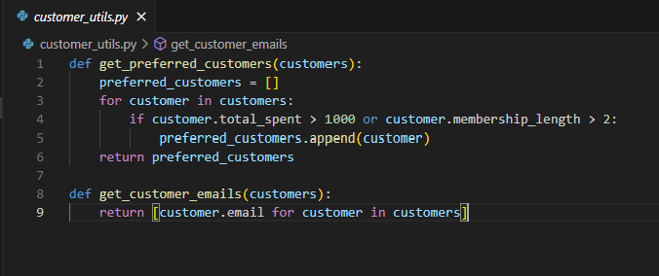
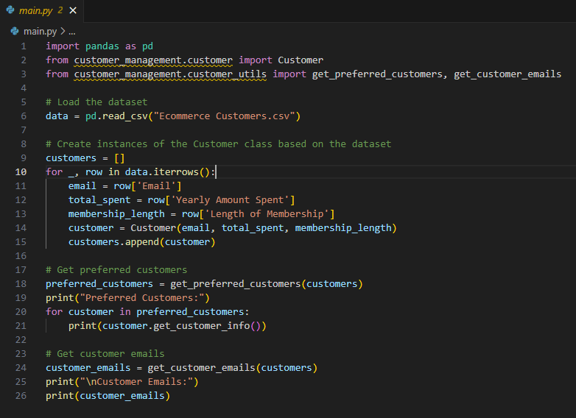
Discussion
How did you find that exercise?
Did you experience any challenges?

Slide 11
Introduction to Packages
What are packages?
Directories that contain multiple modules
Organise related modules into a hierarchical structure
Easily shared and reused across different projects

Slide 12
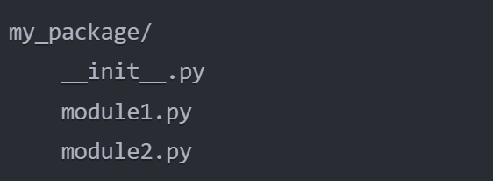
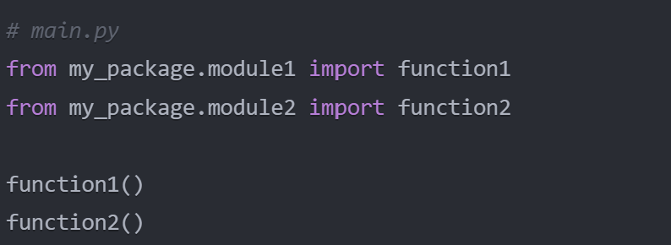
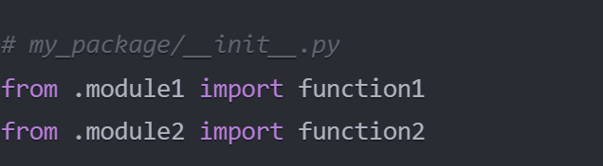
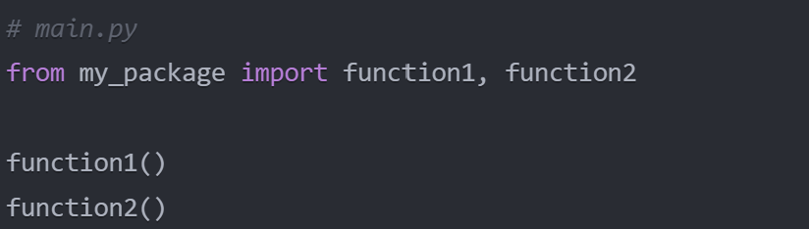
Creating Packages
Create a new directory
Add an __init__.py file
__init__.py file initialises the package
Import modules from a package

Slide 13
https://github.com/Gromm21xx/Modules-Packages-VirtualEnvironments.git
Practical Exercise 2: Creating Packages
Exercise instructions:
Create a new directory called customer_management inside the existing customer_management directory.
Move the customer.py and customer_utils.py files into the new customer_management directory.
Create a new file called __init__.py inside the customer_management directory. Leave this file empty.
Open the main.py file in the root customer_management directory.
Update the import statements in main.py to use the package name when importing the Customer class and utility functions:
Import the Customer class from customer_management.customer
Import the get_preferred_customers and get_customer_emails functions from customer_management.customer_utils
In main.py, use the imported classes and functions:
Load the "Ecommerce Customers.csv" dataset using pandas.
Create instances of the Customer class based on the dataset.
Use the get_preferred_customers function to get the preferred customers and print their information.
Use the get_customer_emails function to get a list of all customer emails and print the list.
Run the main.py script and verify that it works correctly with the new package structure.
Stretch Activity:
Inside the customer_management package directory, create a new file called customer_analytics.py.
In customer_analytics.py, define a function called get_top_customers(customers, n) that takes a list of customer instances and an integer n as parameters. This function should return a list of the top n customers based on their total amount spent.
Open the main.py file in the root customer_management directory.
Import the get_top_customers function from the customer_management.customer_analytics module.
Call the get_top_customers function with the list of customers and a desired value of n, and print the information of the top customers.
Run the main.py script and verify that the top customers are displayed correctly.

Slide 14
Discussion
How did you find that exercise?
Did you experience any challenges?

Slide 15
Introduction to Virtual Environments
What are virtual environments?
Isolated Python Environment
Manage packages separately for each project
Avoid conflicts between projects
Easier to reproduce

Slide 16
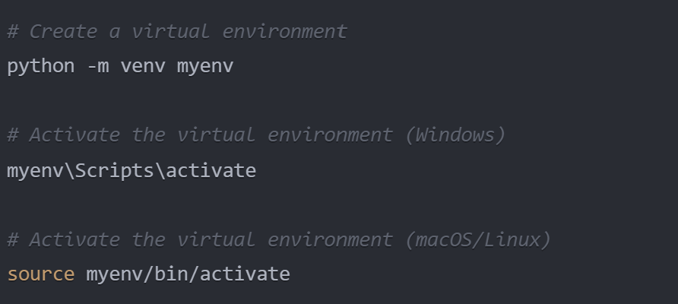
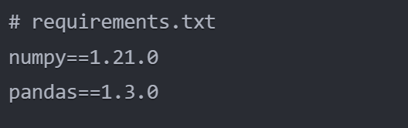
Creating Virtual Environments
Venv module in Python
Create environment using -m venv
Activate environment
use a requirements.txt file to specify the required packages for your project.
To install packages from requirements.txt file run pip install -r requirements.txt
Deactivate the environment by running the deactivate command

Slide 17
https://github.com/Gromm21xx/Modules-Packages-VirtualEnvironments.git
Practical Exercise 3: Creating/ Activating Virtual Environments
Instructions:
Open a terminal or command prompt and navigate to the customer_management directory that contains the main.py file.
Create a new virtual environment called myenv using the appropriate command for your operating system.
Activate the virtual environment using the appropriate command for your operating system.
Install the necessary dependencies (pandas) inside the virtual environment using pip.
Run the main.py script within the virtual environment.
Deactivate the virtual environment when you're done.

Slide 18
Discussion
How did you find that exercise?
Did you experience any challenges?

Slide 19
CHEAT SHEET
Modules
Packages
Virtual Environments
A virtual environment is an isolated Python environment for managing project dependencies.
A module is a Python file (.py) containing definitions and statements.
A package is a directory containing multiple modules and an __init__.py file.
Use python -m venv myenv to create a virtual environment named "myenv".
Use import to access modules and their contents.
Use import with the package name and module name to access modules within a package.
Activate a virtual environment using the activate script in the virtual environment's directory.
Deactivate the environment using the deactivate command

Slide 20
THANK YOU

